Slide 1
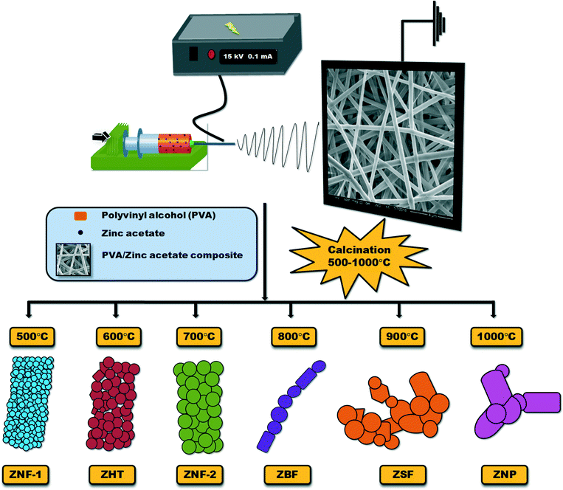
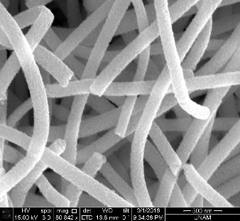
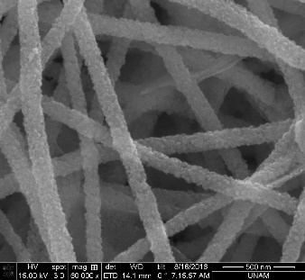
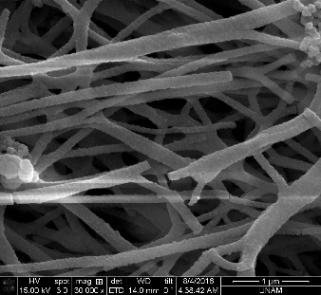
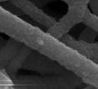
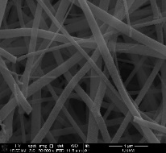
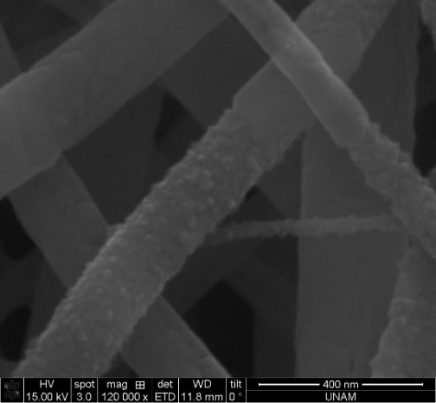
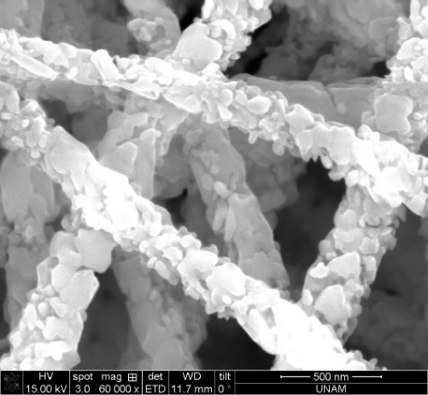
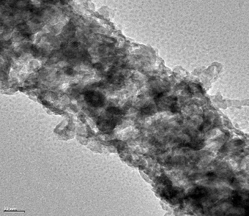
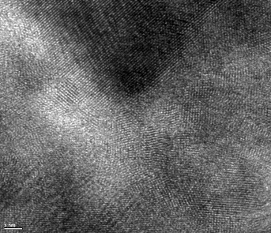
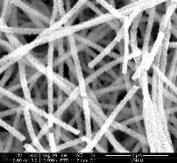
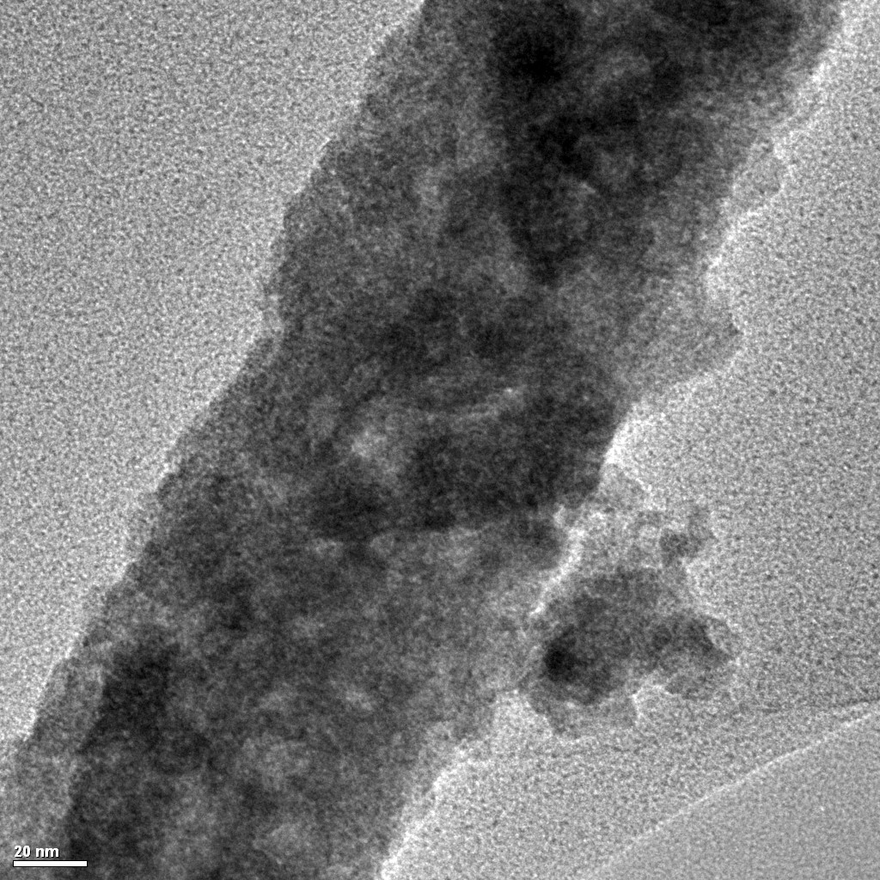
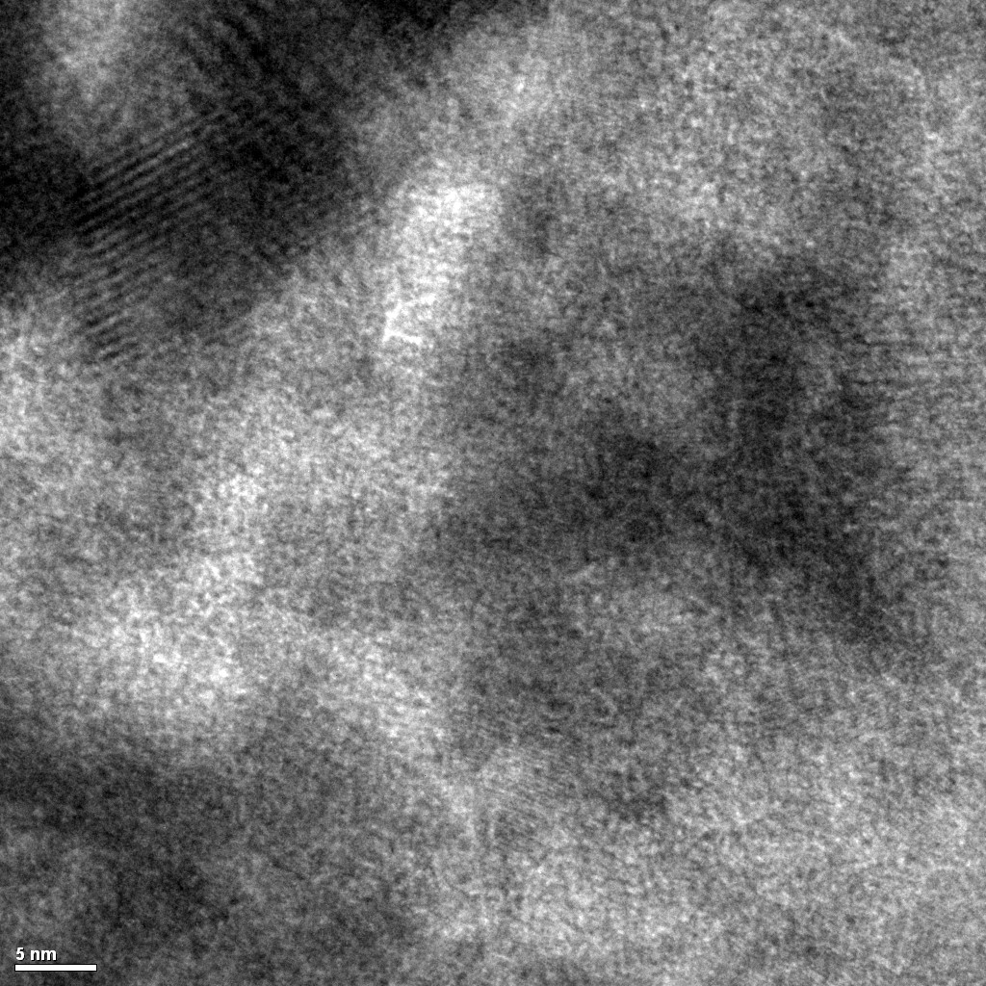
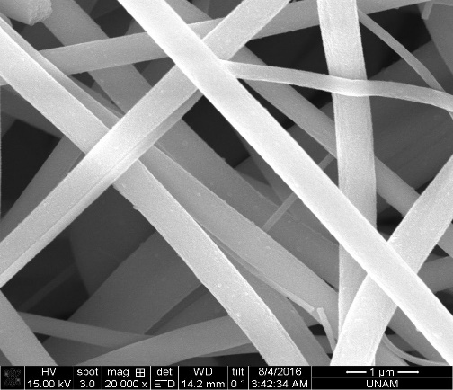
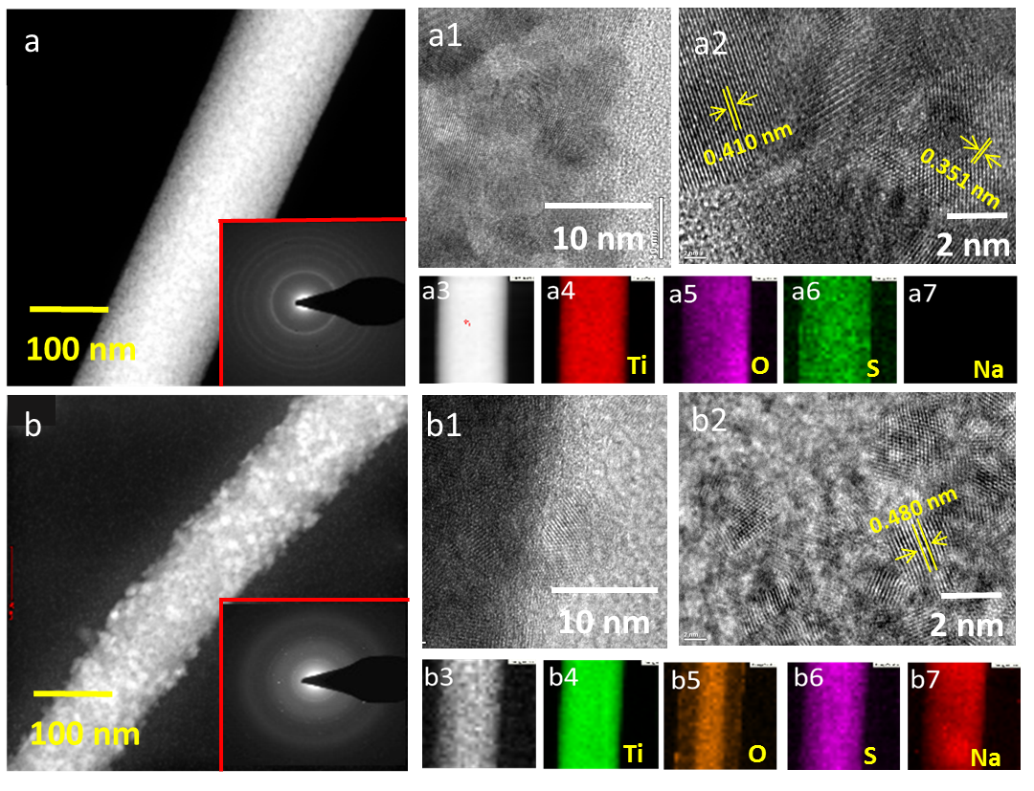
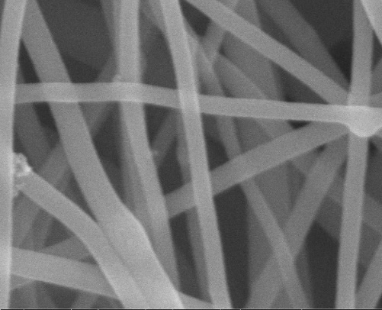
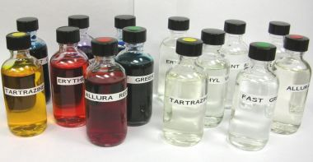
Metal Sulfide Nanograins as Shell Wall on Wide Band Gap Metal Oxide Nanofiber Heterostructure: Efficient Visible Photocatalytic Activity through Bandgap Narrowing
Ranjith Shanmugam, Anitha Senthamizhan, Brabu Balusamy and Tamer Uyar
UNAM--Institute of Materials Science and Nanotechnology, Bilkent University, Ankara, 06800-Turkey
tamer@unam.bilkent.edu.tr
Introduction
Narrow band function on wide band gap semiconductors
Designing Metal sulfide as a shell layer has interested the construction of new set of heterostructure which induces the narrow band function at the interlayers with attracted functional properties for promising remediation based applications. Construction of heterostructures on electrospun nanofiber initiates the directionated carrier mobility and effective charge separation with nanograin assembled structural morphology.
External sulfide based shell wall induced narrow band function on electrospun wide band semiconductors such as TiO₂, ZnO, ZnTiO₃, BaTiO₃, SrTiO₃ having a surface nanograined architecture resembling higher surface interaction.
Through grained surface S ions migrated, which later induces the different shell wall thickness on nanofiber morphology.
Shell wall thickness on narrowing the band gap
-- core shell interface from surface
Visible response
-- Visible active by bandgap narrowing
suppression of carrier recombination
-- Oxygen and sulfur induces defect
with type II band function
Calcined
at
400°C
E (eV)
E (eV)
hv
CB
-0.63
to
-0.20
CB
Ag₂S
CB
CB
Bi₂S₃
O_{v}
Polymer complex
(PVA)/PVP
Polymer/Metal
precursor composites NFs
Metal oxide NFs
3.17 eV -3.4 eV
2.58 eV
2.28 eV
0.89
CuS
CB
e-
e-
e-
e-
O₂
3.2 eV
2.28 eV
Metal precursor
2.20
e-
2.58 eV
SO³
Increasing the sulfidation time
0 min
VB
2.54
to
3.04
VB
2.42
Oxygen vacancies of metalic states
O₂⁻
VB
Pristine M-O NFs
Sulfur modified M-O NFs
Sulfur defect states
h+
h+
h+
h+
.OH
CO₂ + H₂O
CB: Conduction Band VB: Valance Band
Carbon impurities
h+
H₂O
Pollutant molecules
Shell wall controlled MO/MS NFs
VB
ZnS, CuS, Ag₂S and Bi₂S₃ based shell layer on ZnO Nanofibers
MS_{x} shell on MTiO₃ (M= Zn, Sr and Ba) Nanofibers
First, through the sulfidation process ZnO-ZnS based heterostructure was constructed on electrospun ZnO nanofiber with different shell wall thickness.
To overcome the demerits of ZnO and TiO₂, MTiO₃ (M= Zn, Sr, Ba) nanofibers were prepared and sulfidated for constructing the MTiO₃-MS core shell nanofibers, where S ions react with the M sites in the MTiO₃ crystal structure.
500 nm
ZnO NFs
ZnTiO₃
ZnO
1µm
0 min
3.2 eV
Ti
Electrospun MTiO₃ NF
Sulfidated MTiO₃ -MS NF
ZnO-ZnS core-shell NFs
2.6 eV
1 μm
100 nm
2 nm
Zn
500 nm
ZnTiO₃-ZnS
ZnO-ZnS
1µm
180 min
Band gap narrowed due to strained conduction band minimum energies and improves the efficiency of interfacial charge separation.
O
f
500 nm
ZnS NFs
1 μm
100 nm
2 nm
S
Higher surface roughness lead to enhanced surface area and core-shell NFs exhibit higher visible response on compared to pristine NFs
ZnS
1µm
540 min
Zn
O
S
Selective sulfidation on titanate fibers leads to the homogeneous sulfide based heterostructures through the surface interaction.
Secondly, addition metal impurities were added in the sulfidation process to construct the ZnO-CuS, ZnO-Ag₂S, ZnO-Bi₂S₃ based core shell heterostructural nanofibers.
SrTiO₃-SrS
M-S shell wall induces the change in band function for effective carrier separation in core shell NFs
a
b
0.26 nm
Visible response by narrow bandgap shell functionality
300 nm
Strongly red-shifted absorption with minimized valance band position
100 nm
ZnO
5 nm
3.2 eV
BaTiO₃-BaS
c
d
0.31 nm
2.4 eV
Visible emission induced through the sulfur induced defects
100 nm
ZnO-CuS
5 nm
Strong appearance of S²⁻ state on the catalyst surface
e
f
0.24 nm
Promising Metal sulfur interaction on surface
Variable oxygen related defects
Change in valance band position
500 nm
ZnO-Ag₂S
Visible catalytic behavior and byproduct quantifying
100 nm
h
5 nm
g
0.29 nm
Core-shell NF catalyst were visibly active with higher degrading rate with effective production of ROS
100 nm
ZnO-Bi₂S₃
10 nm
Mono or thin layered TiS₃ Shell on TiO₂ nanofiber
Enhanced visible catalytic behavior
Effective carrier separation promotes the ROS
Higher photo corrosive stability
Stable catalytic properties even after 8 reusable cycle with structural stability
In sulfidation process, the stable TiO₂ leads to monolayer decoration of TiS₃ shell functionality with optical gain through the oxygen defects along with the sulfur interstitial defects.
TiO₂
314 eV
500 nm
2.28 eV
CONCLUSION & FUTURE WORK
TiO₂-TiS₃
Extended visible
absorption
Increased oxygen
Vacancies
Minor trace of S²⁻
on surface
Inducing deeper perception and understanding of core-shell heterostructured NF architecture which play a critical role in improving visible catalytic activity by narrowing the band gap. It could initiate possible functional hybrid systems with metal sulfide counterparts for photoresponsive tunable functional applications.
500 nm
TiO₂-TiS₃:Na
References
500 nm
[1] F. Xiao, J. Miao et al., Small. 2015, 11, 2115-2130.
[2] Junyu Zhang et al., Mater. Chem. Front, 2017, 1, 231-250.
[3] Ranjith et al., Catalysis Science and Technology, 2017, 8, 1167- 1180.
[4] Sovio J. A. Monix et al., Energy and Environment Science, 2015, 8, 731-759.
[5] Yajun Wang et al., Nanoscale, 2013, 5, 8326-8339.
Supports

