Slide 1
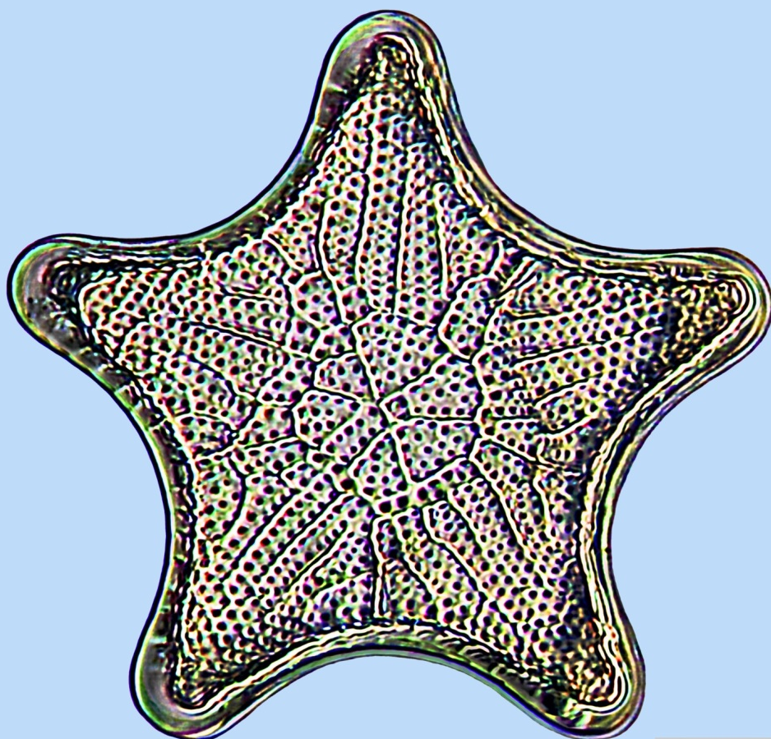
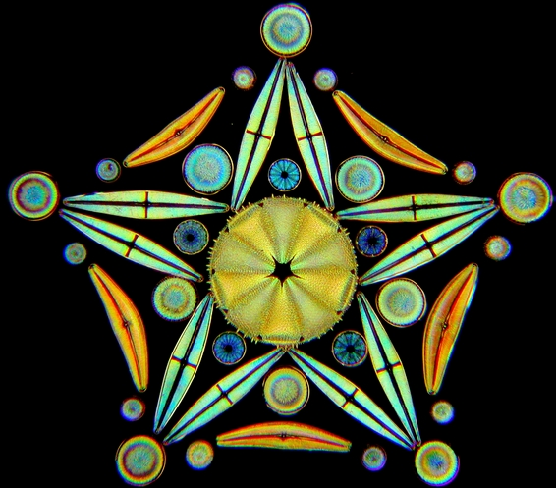
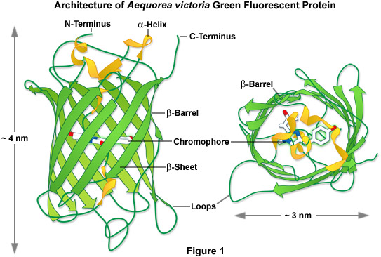
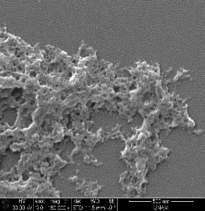
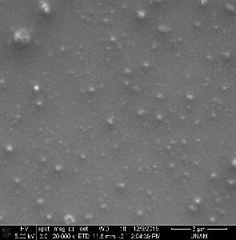
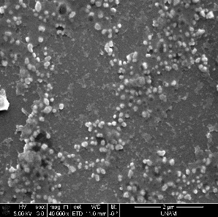
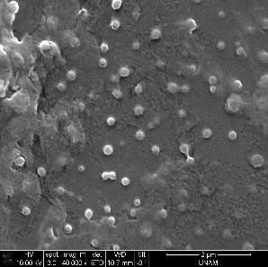
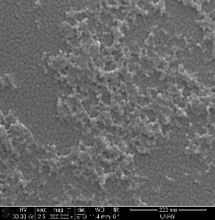
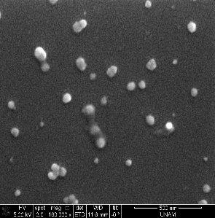
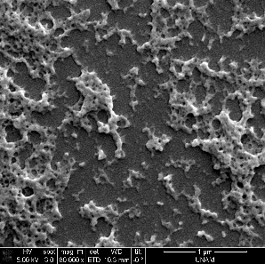
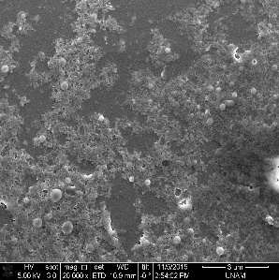
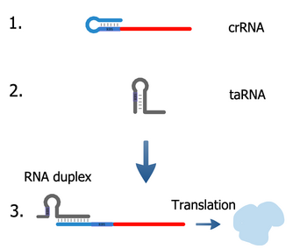
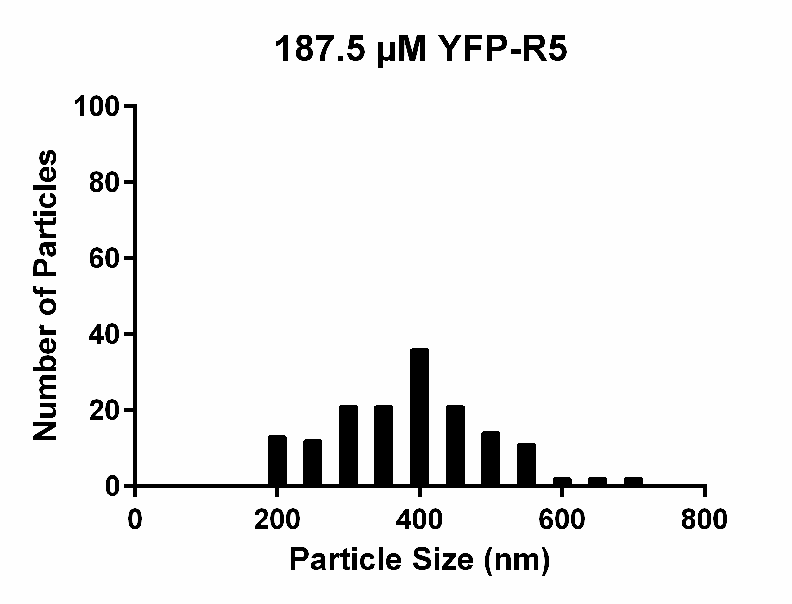
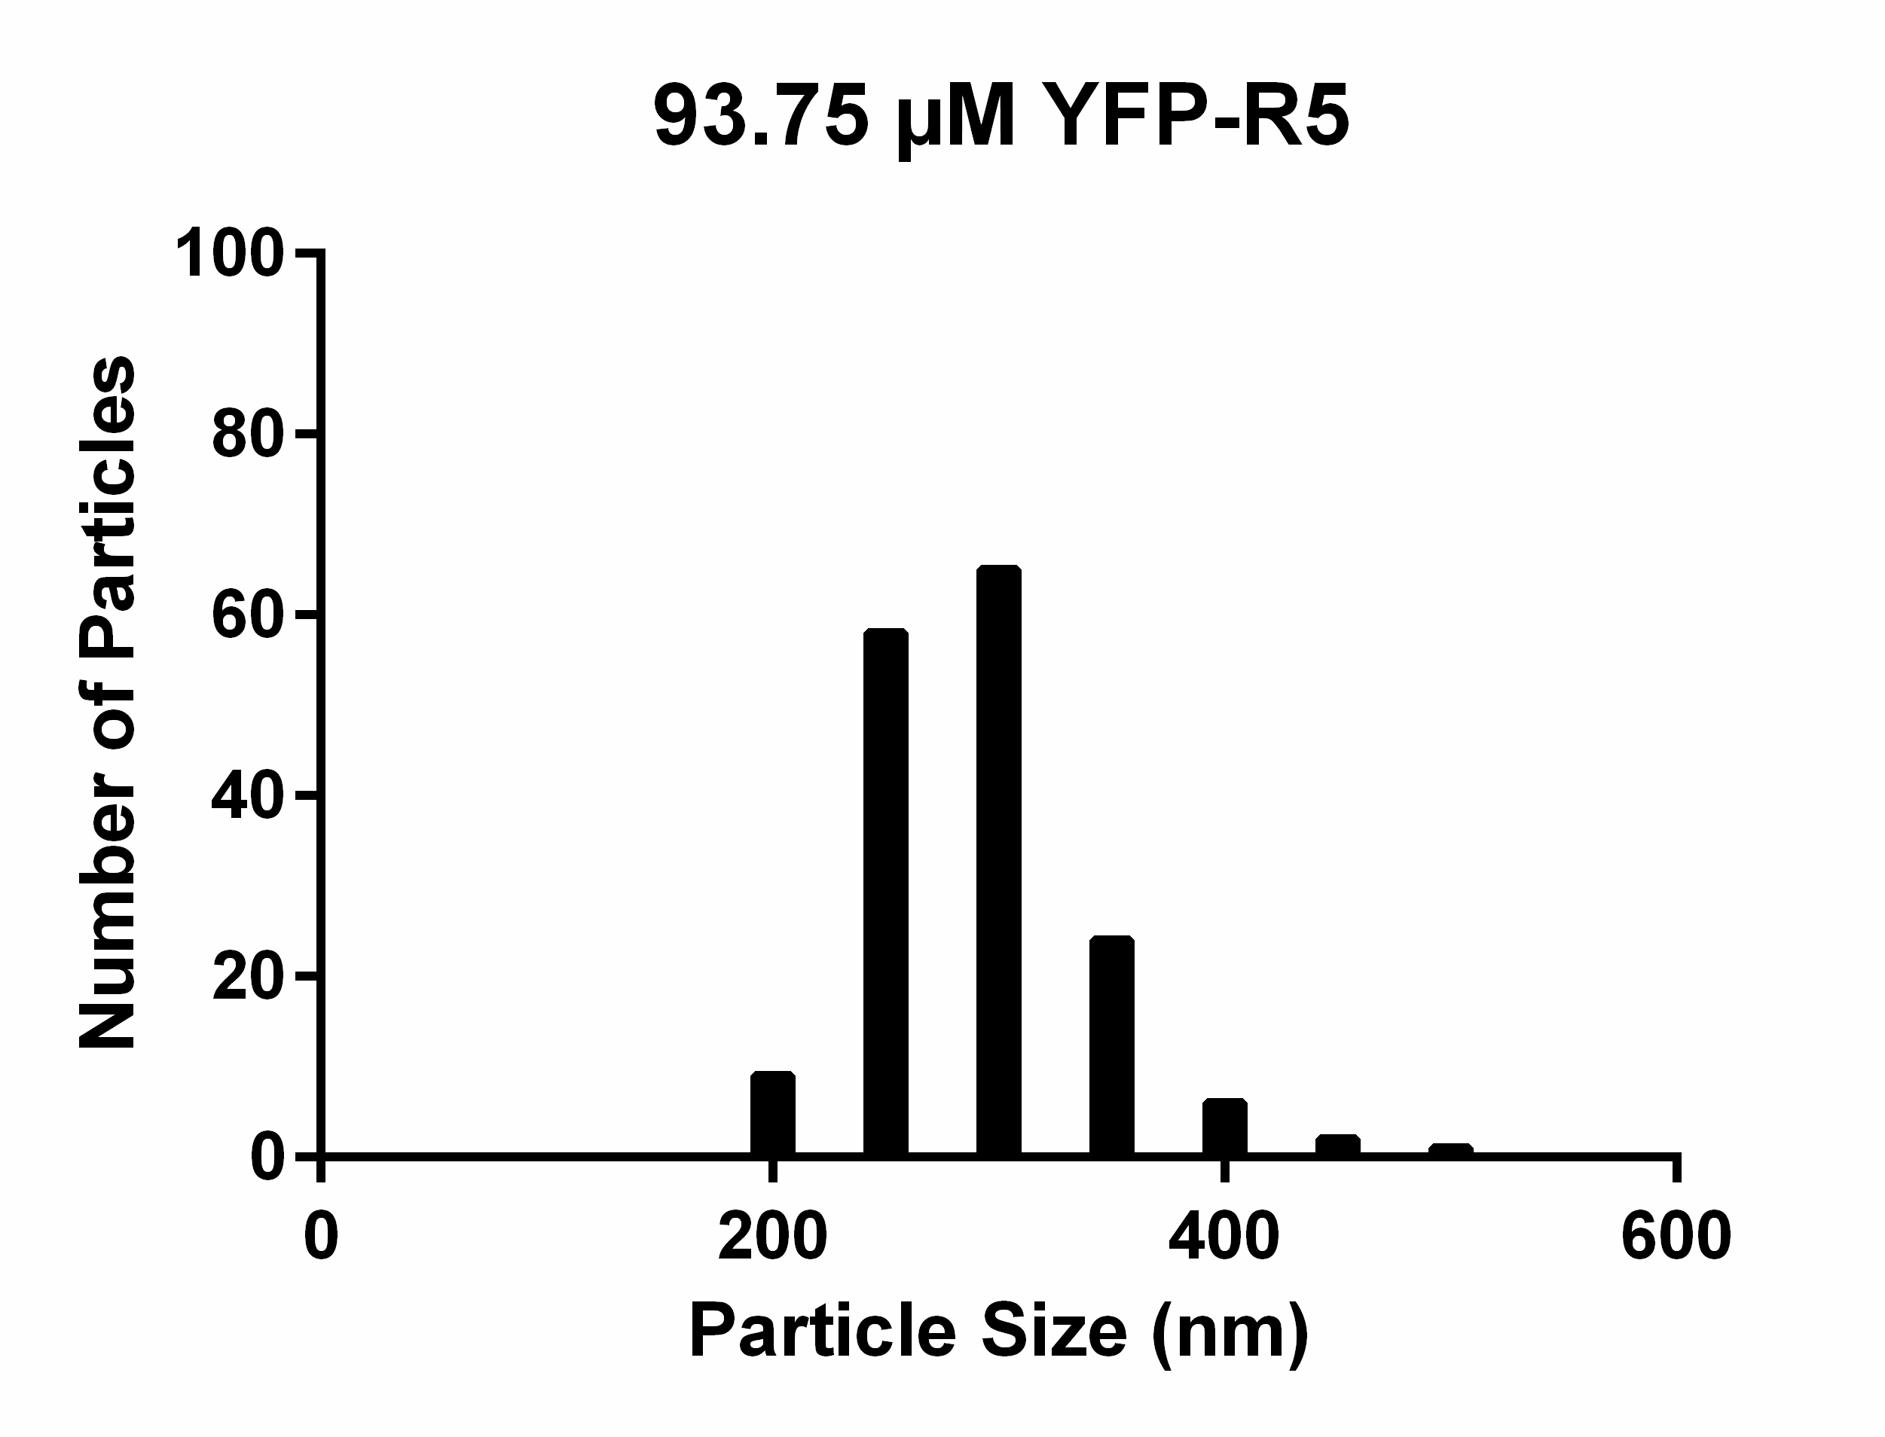
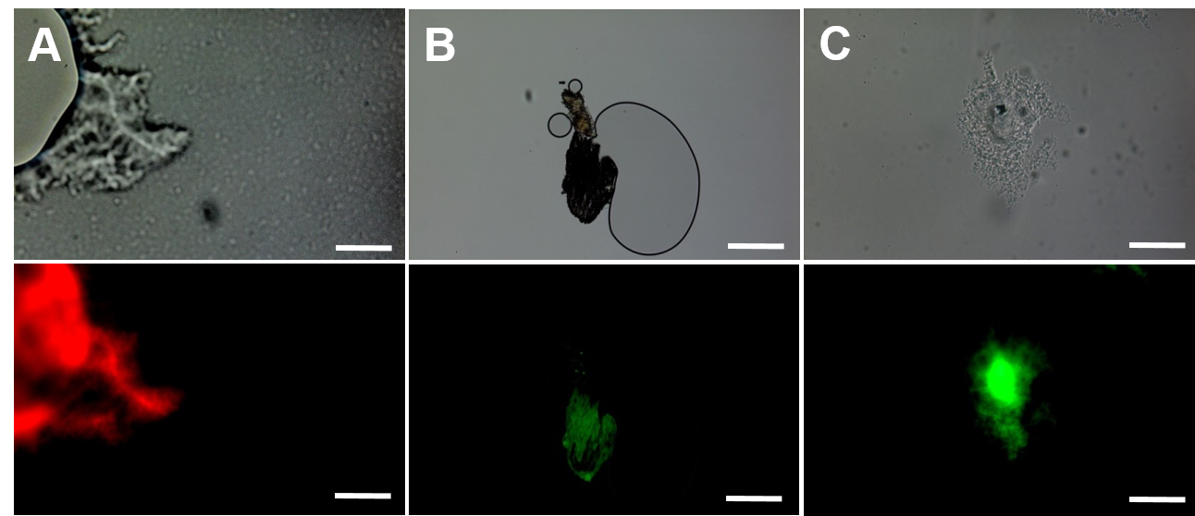
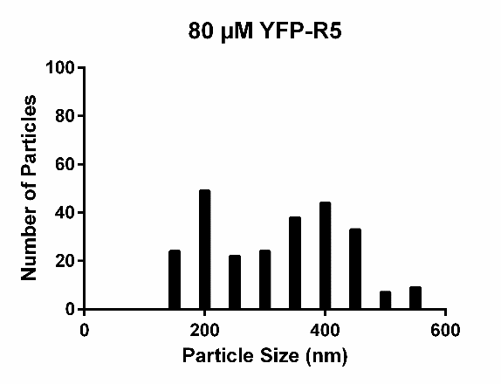
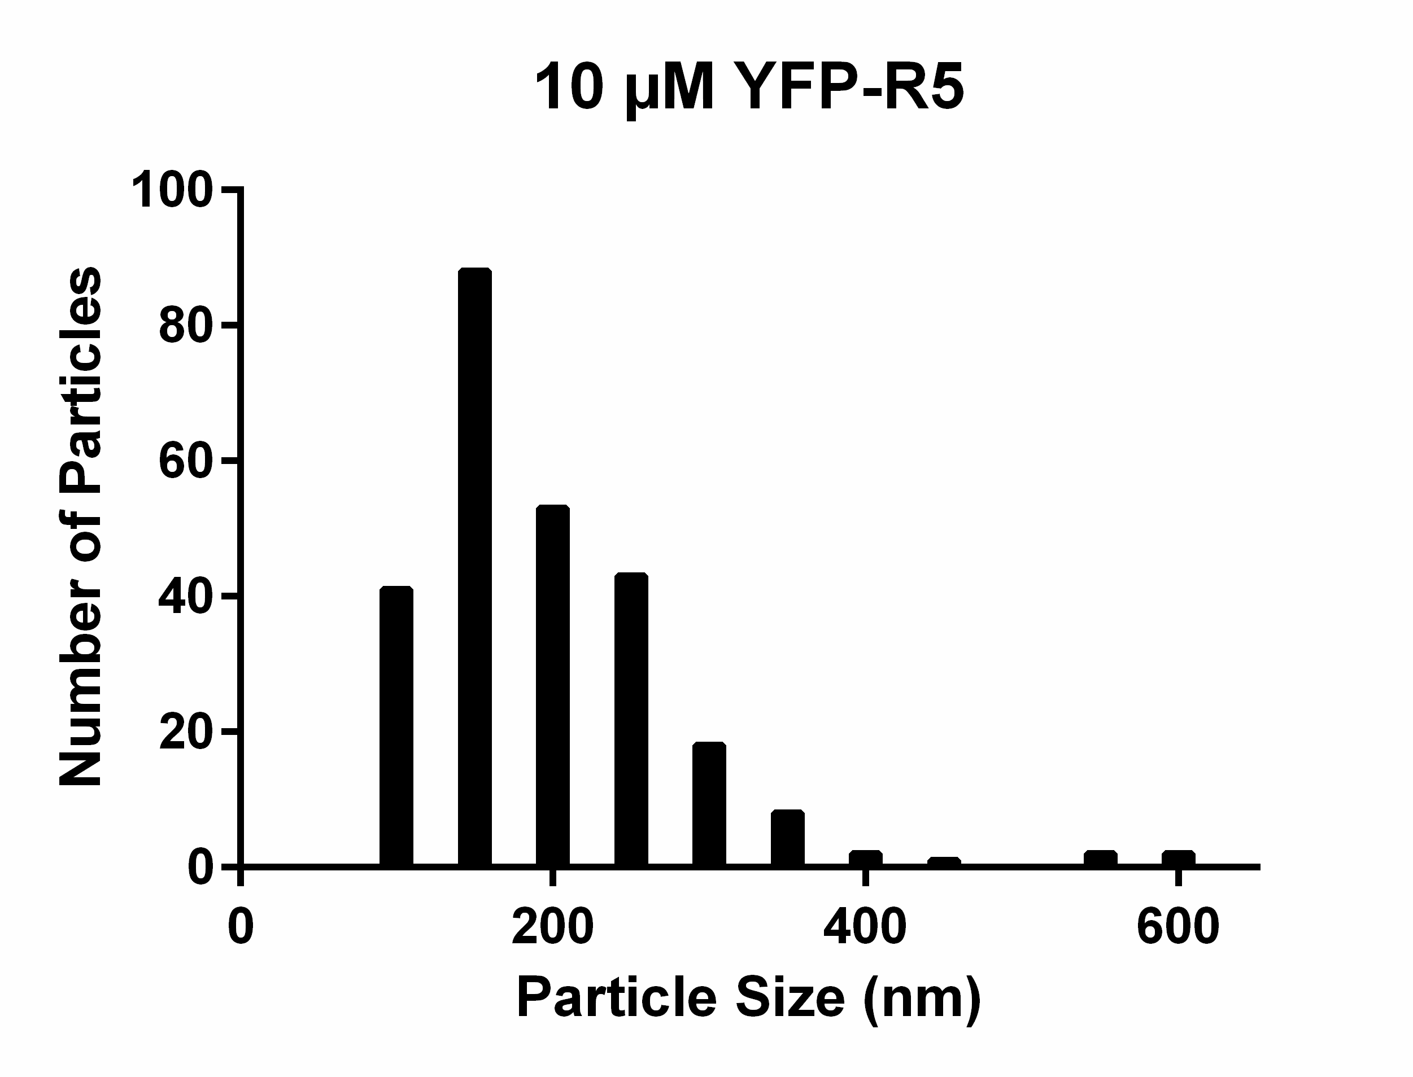
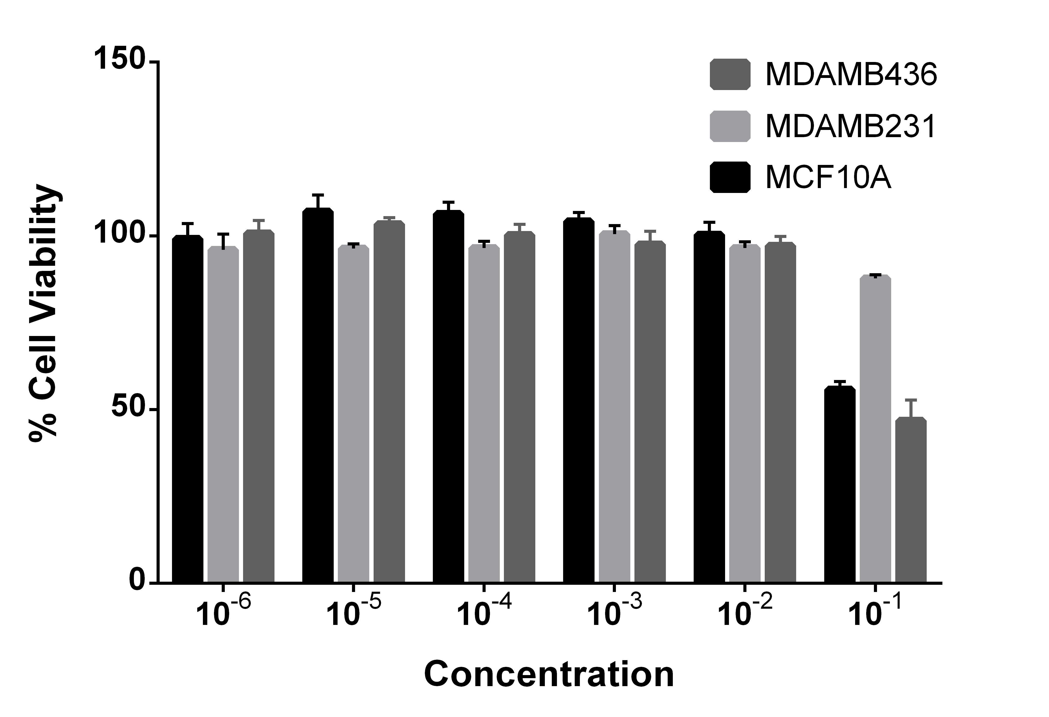
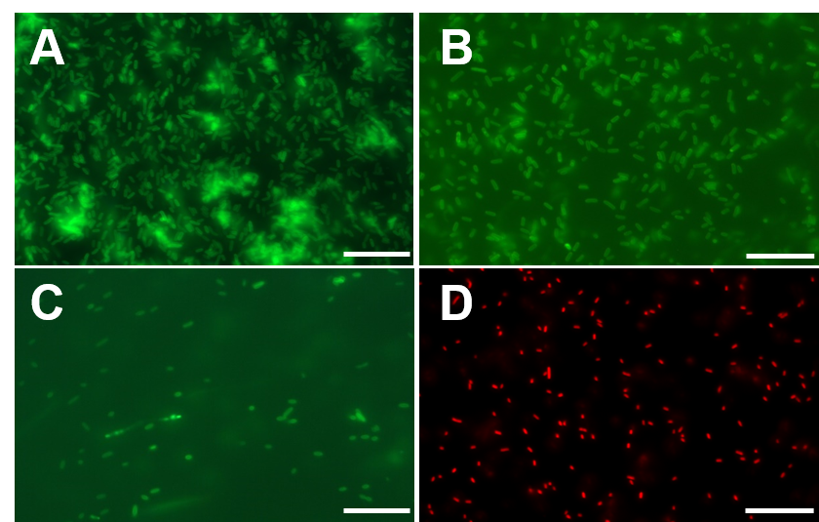
AUTONOMOUS SYNTHESIS OF SILICA HYBRID BIONANOMATERIALS BY BIFUNCTIONAL FLUORESCENT PROTEIN TAGS
Tolga Tarkan Olmez^{1,2}, Esra Yuca^{1,4}, Erol Eyupoglu³, Hazal Beril Catalak³, Ozgur Sahin³, Urartu Ozgur Safak Seker^{1,2}
¹UNAM - National Nanotechnology Research Center, Bilkent University, Ankara, Turkey
²Institute of Materials Science and Nanotechnology, Bilkent University, Ankara, Turkey
³Department of Molecular Biology and Genetics, Bilkent University, Ankara, Turkey
⁴Department of Molecular Biology and Genetics,Yildiz Technical University, İstanbul, Turkey
tolga.olmez@bilkent.edu.tr
INTRODUCTION
PROTEIN PURIFICATION FROM SILICA RESIN
Diatoms have the ability to synthesize extremely diverse hierarchical biogenic silica nanostructures called frustules. These intricate and stunning nanostructures are formed by the help of several proteins and charged biomolecules.
Biomineralization of silica nanomaterials has been an interest due to its unexpected abundance in biology, second only to calcium carbonate (CaCO₃)⁴. The prime example of silica remnants of the past are diatomaceous earth (composed mostly of frustules), which is used as an abrasive agent, porous support, thermal insulator, bug repellant and filtration aid in industry.
Silaffin is one of the proteins that is responsible for crafting bioavailable hydrated silica into diverse shapes. R5 subunit of silaffin enzyme is shown to have the ability to single handedly nucleate silicic acid to form silica nanostructures.
UV
SiO₂
Elution
Figure 7: Purification system of FPs using a silica binding resin. Left panel shows the binding of the proteins to the resin and right panel shows the elution from the resin by 1M l-lysine.
Figure 9: Affinity and binding of purified proteins to the quartz crystal silica surface. Affinity of fluorescent proteins to the silica surface is concentration dependent.
Silica tag is retrieved from Cylindrotheca fusiformis, a diatom whose genomic sequence is known. Silica tag is known as silaffin R5 peptide and its chemically synthesized counterpart is shown to synthesize silica nanoparticles in ambient conditions⁵.
35
25
GFPhis YFPhis mCherryhis
Before After Before After Before After
Figure 1: Upper Graph, diatom Triceratum pentacrinus¹.Lower Graph, artistic representation of T. pentacrinus (or T. pradesus) by 7 diatom species².
35
25
GFPR5 R5GFP YFPR5 mCherryR5
Before After Before After Before After Before After
Figure 8: Comparison of purification methods. Lower panel silica purification, upper panel histidine purification kit.
Figure 10: Upper panel: Excitation-emission pairs of FPs used in this study. Lower Panel: Time Resolved Fluorescence graphs showing the fluorescence characteristics and decay time.
Functional tags also used widely in the process of protein purification. Previously a silica tag called Car9 was shown to be utilized in the process of as a silica based protein purification system⁶.
For our study, we have designed and synthesized R5 tagged monomeric bright fluorescent proteins (GFPmut3, Venus YFP and mCherry RFP) in order to both make the proteins responsive to the silica purification system and make them attract silica precursors in order to synthesize fluorescent silica nanoparticles.
FLUORESCENT SILICA NANOPARTICLE SYNTHESIS AND CHARACTERIZATION
Protein Concetration
TMOS Concentration
Effect of Washing with Buffer
The synthesis of silica nanoparticles were performed by modified Ströber process, where the positively charged molecule is replaced by the purified protein.
Triple washed samples that are having the 25 uM of TMOS and 20 uM of modified protein produced the best results for synthesis.
80 µM FP-R5
100 µM TMOS
no washing step
three washing steps
Figure 2: Green fluorescent protein structure and functional domains³.
500 nm
3 µm
2 µm
0x
2 µm
DESIGN, CLONING AND EXPRESSION OF MODIFIED FLUORESCENT PROTEINS
20 µM FP-R5
25 µM TMOS
one washing step
five washing steps
250 nm
500 nm
1 µm
4 µm
Figure 11: Optimization of silica nanoparticle synthesis conditions.
Figure 3: Genetic model showing the positioning of functional genetic parts.
Figure 4: Riboregulator system that is upstream to the FP expression unit.
(Left). Genetic map of designed construct R5GFP (right).
nucleation
growth
encapsulation
Figure 13: Fluorescence of synthesized silica structures in fluorescence microscopy. mCherrR5, GFPR5 and YFPR5 respectively.
Optimization conditions and synthesis of fluorescent silica nanoparticles was shown in several ways. We can reduce the silica nanoparticle size by reducing the added fluorescent protein to the reraction mix.
Colocalization of silica and the organic content is shown by TEM (Transmission Electron Microscopy) and EDS (Energy Dispersive Spectroscopy).
Figure 12: Silica particle size distribution change depending on the concentration of protein added.
FP-R5
TMOS
Silica nanoparticles
A
Figure 5: Model showing the synthesis of fluorescent silica nanoparticles in the presence of silica precursors
An inducible promoter with a riboregulator system was utilized in this study. aTc (inducer) binds to both promoters (promoter of taRNA and FP-R5) to activate downstream transcription. taRNA inhibit the repression that is conferred by the crRNA on the RBS.
TMOS (tetramethylorthosilicate) was hydrolized in an acidic solution and synthesis of fluorescent silica nanoparticles begin only after addition of fluorescent protein R5.
B
Figure 15: Cell viability assay that shows the silica toxicity.
Cell culture studies was designed to determine the intracellular toxicity of nanoparticles.
Fluorescent silica nanoparticles show toxicity when present only in very high concentrations.
Figure 6: Fluorescence microscopy images showing the expression of modified FPs when induced by aTc (anhydrotetracycline).
C
N
O
Si
Merged
CONCLUSION & FUTURE WORKS
Figure 14: A) EDS and TEM results for GFPR5 and mCherryR5 showing the colocalization of silica and fluorescent proteins. B) EFTEM result for YFPR5.
Our study shows the synthesis of silica nanoparticle synthesis by the fusion constructs of the fluorescent proteins. R5 is one of the seven processed end products of the natural silaffin protein from C. fusiformis and used as a bifunctional tag, both to purify the protein crude extract and to synthesize silica nanoparticles. We have shown that fusion of silica binding tags to a palette of FPs can results in successful synthesis of encapsulated silica-FP biohybrids. Excitation-emission spectra of FPs does not significantly change after silica addition.
We also show that the particle size can be controlled by changing the concentration of FPs added to the reaction mixture without changing any of other parameters. We expect that the modified fluorescent protein - silica conjugates can display better fluorescence characteristics than the classical FPs used in many areas of the biology.
REFERENCES
SUPPORTS
[1] Adolf Schmidt - Atlas der Diatomaceenkunde Plate 98 / Figs 7, 9-10
[2] Dominique Prades. http://forum.mikroscopia.com/topic/9649-triceratium-pentacrinus/
[3] Zeiss microscopy online campus, Florida State University.
[4] Elizabeth Trembath-Reichert, Jonathan Paul Wilson, Shawn E. McGlynn and Woodward W. Fischera. PNAS, 2015. 2, 3
[5] Laura Senior, Matthew P. Crump, Christopher Williams, Paula J. Booth, Stephen Mann,cAdam W. Perriman and Paul Curnow, J. of Materials Chemistry B., 2015, 39,5.
[6] Coyle BL, Baneyx F.,Biotechnol. Bioeng., 2014, 355, 4
TÜBİTAK
We thank to TUBITAK for funding.
Project number:
115M108 and 114M163

