Slide 1
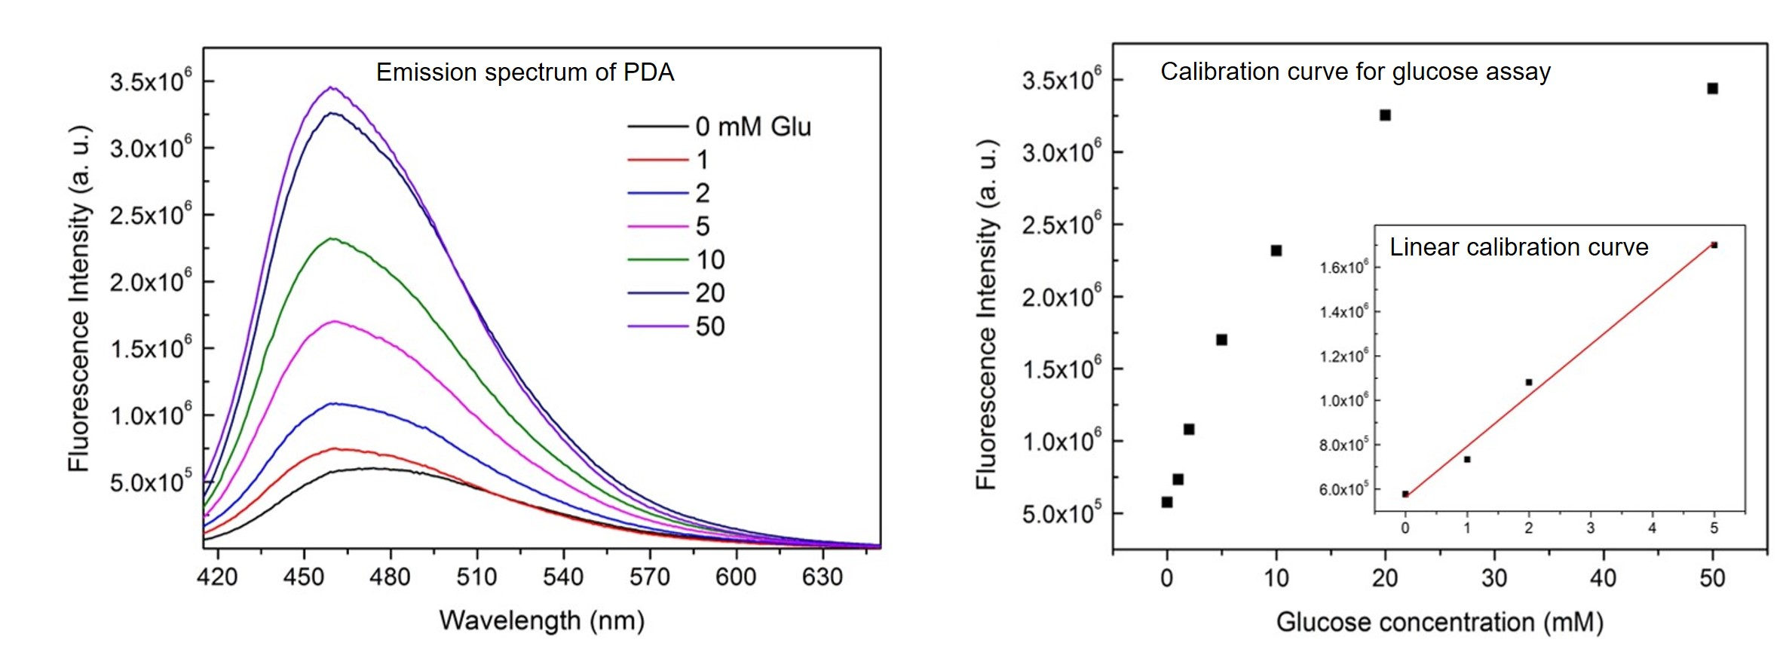
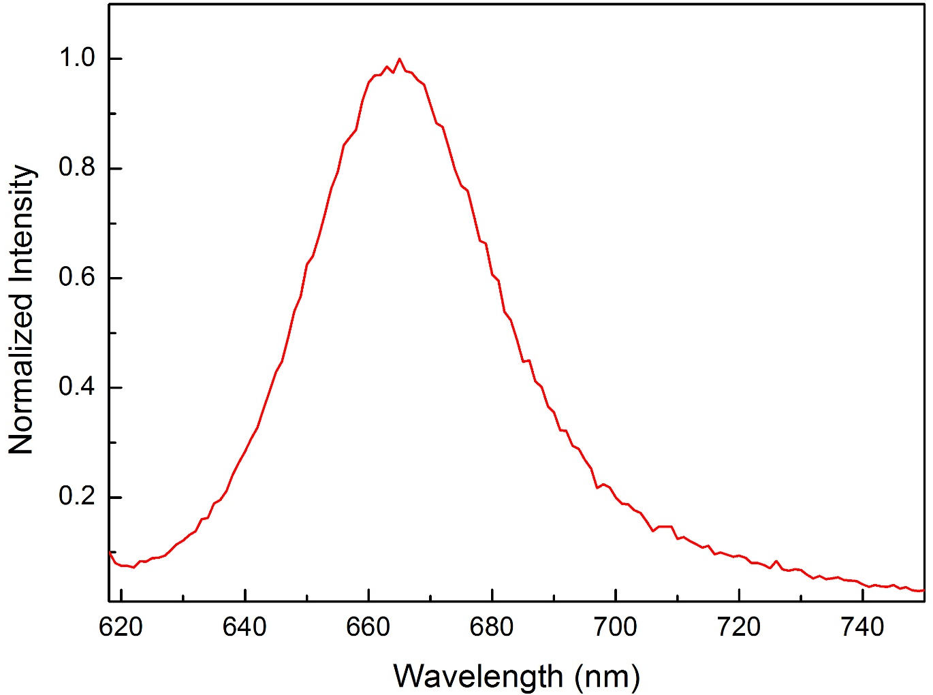
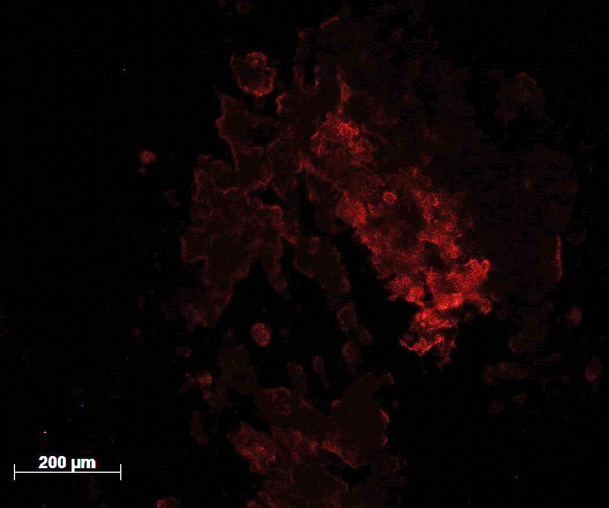
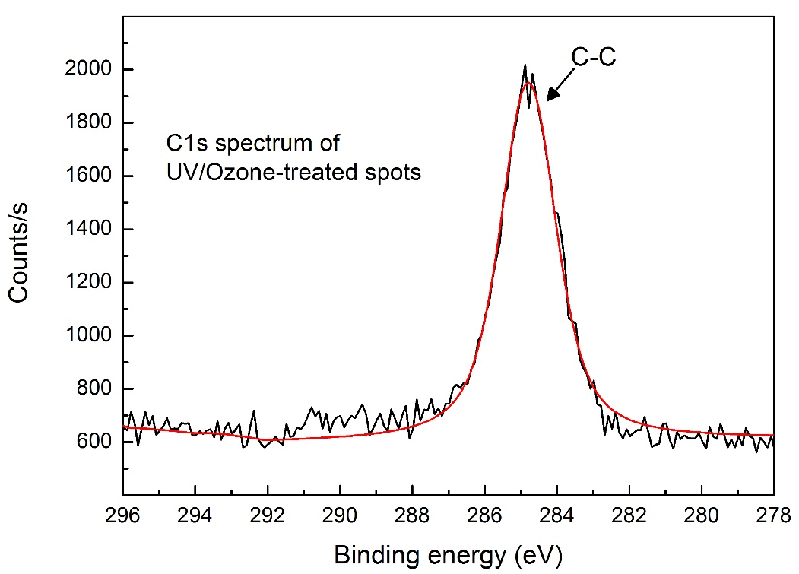
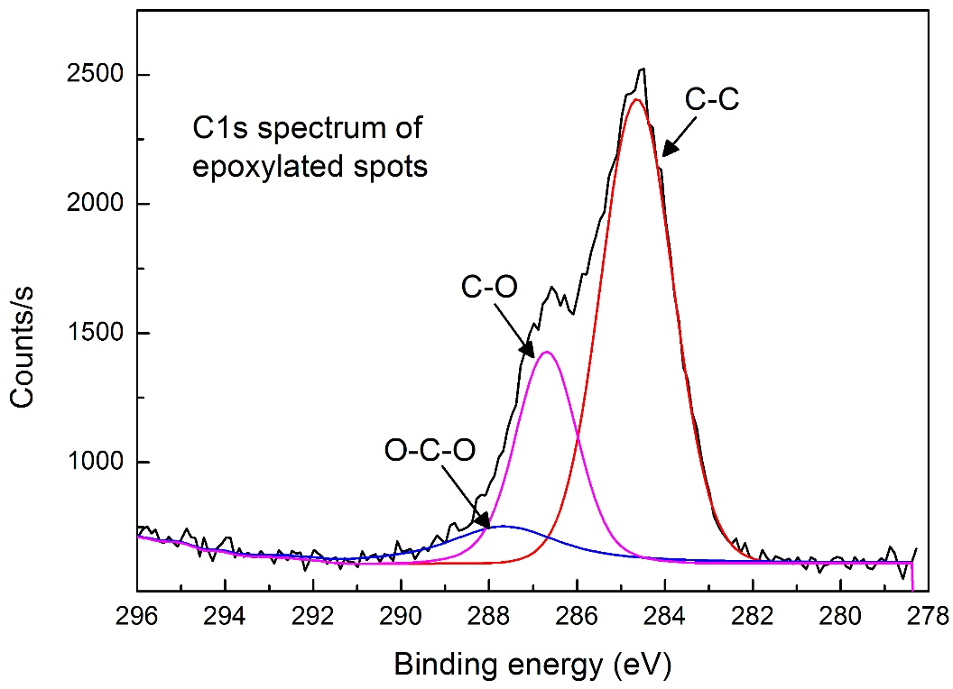
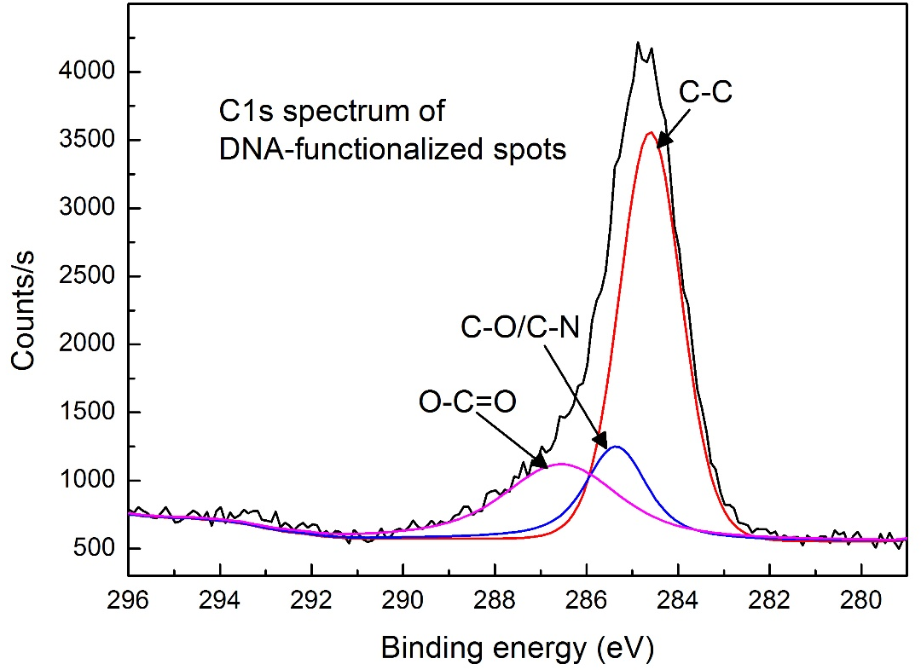
ON-CHIP BIOSENSING USING SUPERHYDROPHOBIC SURFACES WITH PATTERNED WETTABILITY
Pinar Beyazkilic,^{1,2}, Abtin Saateh,^{1,2} and Caglar Elbuken^{1,2,*}
¹UNAM - National Nanotechnology Research Center, Bilkent University, Ankara, Turkey
²Institute of Materials Science and Nanotechnology, Bilkent University, Ankara, Turkey
*elbuken@unam.bilkent.edu.tr
SURFACES WITH PATTERNED WETTING
GLUCOSE DETECTION
We produced functional surfaces with superhydrophobic and superhydrophilic patterns.
Superhydrophobic organically modified silica (ormosil) films were produced via sol-gel process¹ and wetted areas were generated on them using simple UV/Ozone treatment.
We discovered sample enriching capability of the wetted spot patterns (~1 mm) upon droplet evaporation and exploited such property in glucose analysis based-on enrichment effect.
Shadow mask
Droplet evaporation decreases transport distances and increases interaction frequencies between molecules, therefore increases detection signals and sensitivity.³
Dyed water droplets
Surface morphology of ormosil coating
In order to perform glucose (Glu) assay, glucose solutions with varying concentrations were incubated with glucose oxidase followed by incubation with polydopamine (PDA) in the 20 µL droplets on the wetted spots at 37 ºC. Incubation of polydopamine and glucose led to bright blue polydopamine fluorescence due to strong oxidizing effect of hydrogen peroxide generated through glucose oxidation reaction and enrichment effect of the wetted spots.
Well-defined superhydrophilic patterns with various size and geometries including stripe and circle can be formed using different mask designs.
High density droplet microarrays can be generated by dipping the surfaces into aqueous media or by rolling a large droplet over the surface.
Biomolecules can be selectively adsorbed on the wetted patterns and their density can be controlled depending on UV/Ozone treatment time.²
Fluorescence plottings and UV images reveal the sensitive enhancement of PDA fluorescence with increasing glucose within the range from 1 mM to 50 mM.
Fluorescent-labelled Bovine-serum albumin (BSA) spot arrays
UV-illuminated fluorescent spots with increasing glucose concentration
DNA DETECTION
In order to perform on-chip DNA analysis based on sample enrichment effect, UV/Ozone activated spot patterns were functionalized with fluorescent-tagged DNA sequence. Before DNA binding, the spots were functionalized with epoxy groups using glycidyloxypropyl-trimethoxysilane (GOPTS). Amine-terminated DNA probes bound to the epoxy-ended silanes. C1s spectra recorded in X-ray photoelectron spectroscopy (XPS), showed successful binding of epoxy-silanes and DNA onto the spots. Furthermore, red fluorescence obtained in fluorescent microscopy and spectrophotometry revealed successful binding of Cy5-labelled DNA.
Fluorescence spectrum of Cy5-DNA on the wetted spot
Fluorescence microscopy image of DNA-functionalized spot
FUTURE WORKS & CONCLUSIONS
As a future work, we will perform the detection of the complementary DNA sequences. Here, we presented smart and functional superhydrophobic surfaces and showed their applications in on-chip biomolecule sensing. Findings indicate great potential of these surfaces in biomedical analysis.
REFERENCES
SUPPORTS
TÜBİTAK-BİDEB SCHOLARSHIP
PROGRAM & PROJECT NO.111T696
[1] H. Budunoglu, A. Yildirim, M. O. Guler, and M. Bayindir, ACS Appl. Mater. Interfaces 2011, 3, 539.
[2] P. Beyazkilic, U. Tuvshindorj, A. Yildirim, C. Elbuken and M. Bayindir, RSC Adv. 2016, 6, 80049.
[3] L. P. Xu, Y. Chen, G. Yang, W. Shi, B. Dai, G. Li, Y. Cao, Y. Wen, X. Zhang and S. Wang, Adv, Mater. 2015, 27, 6878.

